Slide 1


ENGLISH LEVEL B1 - II
Lesson 06
TALKING ABOUT THE ENVIRONMENT
Notes:
Teacher’s Notes:
Explain the lesson goal: learning words and sentences related to hospitals.
Ask students: Have you ever been to a hospital? Why?

Slide 2

01
Learn words to talk about the environment
02
Practice speaking and working in groups
03
Help the planet by talking about nature
ENGLISH LEVEL B1 - II
Notes:
Teacher notes: Introduce key vocabulary related to the environment and encourage students to discuss its importance.
Have them practice speaking in groups and share their ideas on protecting nature.

Slide 3
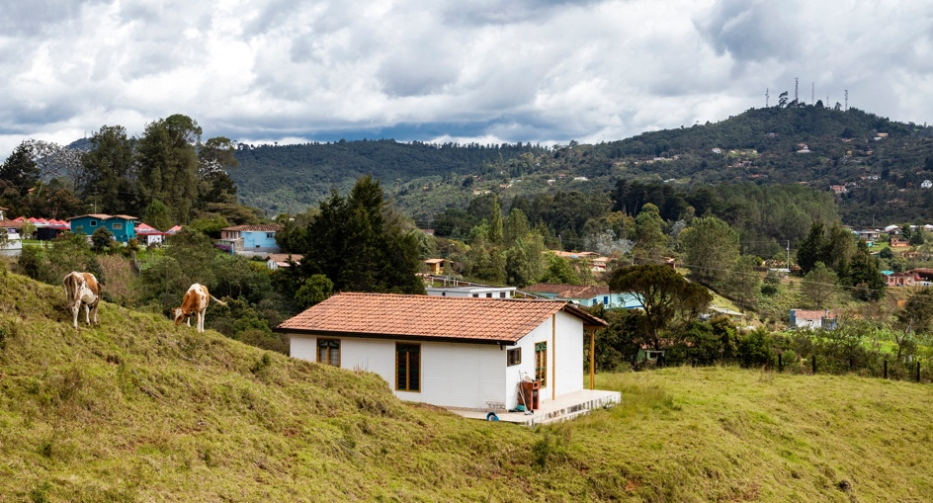
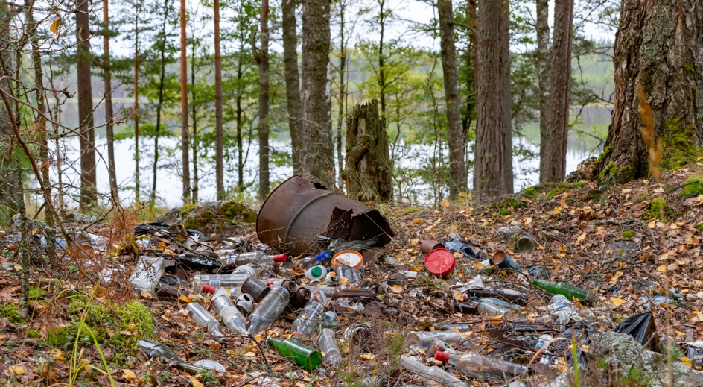
TALKING ABOUT THE ENVIRONMENT
LET’S TALK ABOUT THE ENVIRONMENT
Look at the pictures and answer the questions.
1
Which place do you like more? Why?
2
What is good or bad about these places?
Notes:
Teacher Notes:
Give students 2 minutes to think.
Let them answer in pairs or small groups.
Encourage them to use simple sentences.

Slide 4
TALKING ABOUT THE ENVIRONMENT
Vocabulary:
Here are some important words:
Nature – Trees, animals, rivers, and all living things.
Pollution – Dirty air, dirty water, or too much trash.
Recycle – Use something again instead of throwing it away.
Protect – Keep safe from harm or danger.
Litter – Trash on the ground in public places.
Environment – The air, water, land, and all living things around us.
Waste – Something that is thrown away, like food or plastic.
Save – Use less of something to protect it, like water or energy.
Clean energy – Energy from the sun, wind, or water that does not pollute.
Global warming – When the Earth gets too hot because of pollution.
Deforestation – Cutting down too many trees from forests.
Endangered species – Animals that are in danger of disappearing
Notes:
Teacher Notes:
Show pictures of nature, pollution, and other concepts.
Students say the words out loud.
Check if they understand the meaning.

Slide 5
TALKING ABOUT THE ENVIRONMENT
Practice the vocabulary!
Complete with the correct word:
The _______ is full of trees and animals.
Factories produce a lot of _______.
We should keep the environment _______.
It is important to _______ water and electricity.
Throwing trash on the ground is a _______ of resources.
Cutting down too many trees causes __________.
The air is __________ because of smoke from cars.
We should __________ paper, plastic, and glass to help the planet.
Animals that are in danger of disappearing are called __________ species.
Notes:
Teacher notes: Students complete the sentences with the correct environmental vocabulary.
Encourage them to discuss their answers and suggest ways to protect the environment.

Slide 6

TALKING ABOUT THE ENVIRONMENT
Pair work – let’s talk!
Work with a partner. Ask and answer these questions:
Example Conversation
1
What can we do to help nature?
A: What can we do to help nature?
B: We can plant trees and save water.
A: Yes! We can also recycle.
A: How can we stop pollution?
B: We can walk or use a bicycle.
A: Good idea! We should also throw trash in the bin.
A: Do you recycle at home?
B: Yes, I recycle plastic and paper. Do you?
A: Yes! I recycle too.
2
How can we stop pollution?
3
Do you recycle at home?
Notes:
Teacher Notes:
Give students 5 minutes to talk.
Walk around and listen to their answers.
Help with pronunciation if needed.

Slide 7
TALKING ABOUT THE ENVIRONMENT
Make Sentences
Put the words in the correct order:
pollution / bad / is →_______________________________
we / water / clean / should →_______________________
trees / important / are →___________________________
planet / protect / we / must /the →_______________________
is / recycling / good →______________________________
should / the / turn off / we / lights →_______________________
trash / the / pick up / please →_______________________
oceans / clean / be / should →________________________
Notes:
Teacher Notes:
Ask students to write the correct sentences.
Let them read their answers aloud.
Correct mistakes gently.

Slide 8
TALKING ABOUT THE ENVIRONMENT
Complete the Sentences
Nature is full of ________ and _________.
We should not ________ our planet.
It is important to ________ paper and plastic.
Wind and sun give us clean ________.
Recycling helps to protect the __________.
The ocean is home to many __________.
We should always __________ water.
The Earth is our __________, and we must take care of it.
Notes:
Teacher Notes:
Give students time to complete the sentences.
Discuss answers as a class.

Slide 9
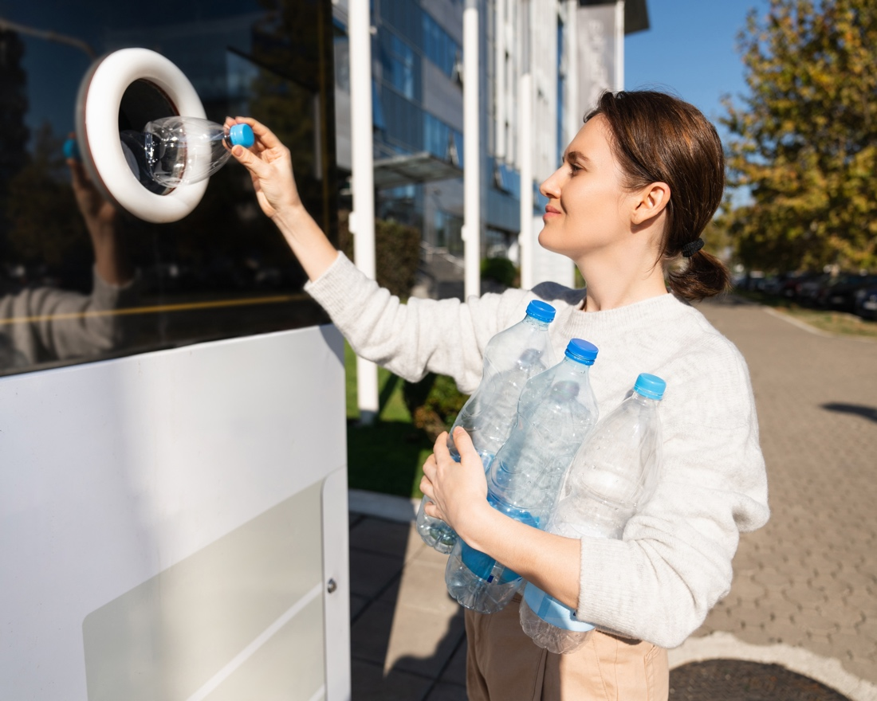

TALKING ABOUT THE ENVIRONMENT
CHECK YOUR LEARNING
Write three sentences about the environment. Share them in the class chat.
Example sentences:
I recycle plastic bottles to help the environment.
Notes:
Teacher Notes:
Encourage students to use vocabulary from previous slides.
Provide feedback on sentence structure and vocabulary usage.

